Slide 1
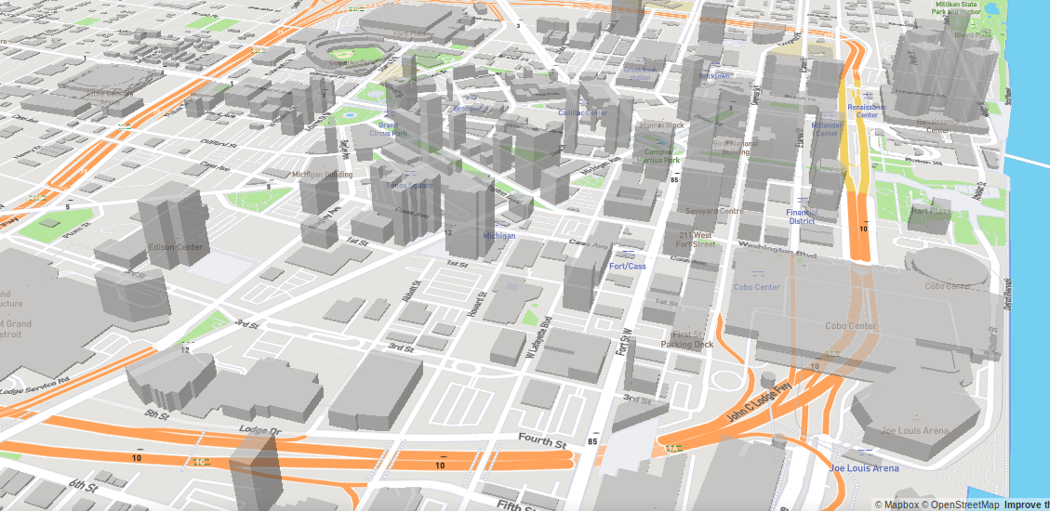
SEMCOG-UrbanSim Bi-weekly
June 20, 2019
Notes:
In this chapter, we will discuss the theoretical basis of UrbanSim at a conceptual level.
Given time constraints, we won’t be able to dive very deeply into the mathematics of the model, but if you are interested in this, at the end of this course we will point you in the direction to where you can fine more technical resources.

Slide 2
Areas of work
Iterating on regionally-estimated specifications, conducting runs, and comparing loss scores / case-study indicators with runs 4036
Setting up calibration script to calibrate each location choice submodel, with the official forecast as the target
Notes:
OLD ONE

Slide 3
Next steps for project (slide from 5/30 meeting)
Job-space level estimation of the ELCM (job spaces as the alts in estimation)
Unit-level estimation of location choice models, simulated by large area
Calibrate proforma
Tune estimated parameter values (plus city dummies) with the calibrator- for each large area and each submodel
Run full simulation with large area controls + calibrated coefficients
Potentially (stretch goal):
Test joint calibration of all components together, over the forecast horizon

Slide 4
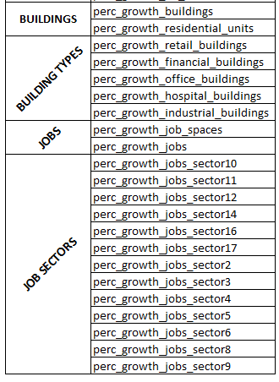
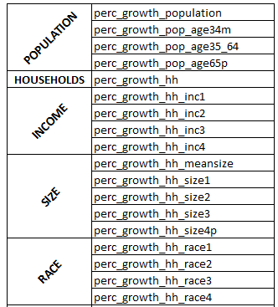
Metrics

Slide 5
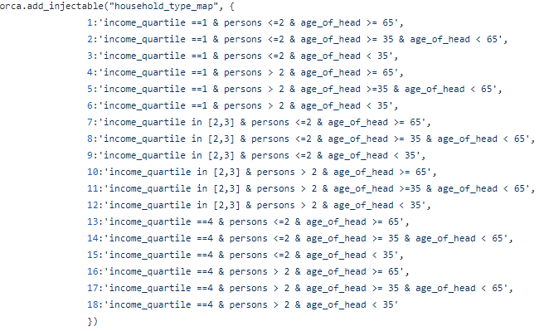
Household Segments
Categories cuts:
Income quartiles: 1, 2&3, 4
Size: <=2 , >2
Age of head: < 35, >=35 & < 65, >=65

Slide 6
SIMULATION RUNS: Specs
SIMPLIFIED RUN: simulation with only the following models:
SEMCOG AS IS: semcog_urbansim repo Simulation models *
REGIONAL SPECIFICATIONS: location choice and price specifications don’t control for large areas.
LARGE AREA CONTROL: variables in location choice models control for large areas.
Clustering Variables: models with variables that aggregate by geographic unit but don’t use the pandana variables. Ex: “st_zones_prop_hh_with_children”, standardized variable that represents the proportion of households with children in the zone).
Accessibility Variables: variables in models from the pandana models (‘neighborhood_vars’). Example: “st_nodes_walk_percent_low_income”.
Notes:
* orca.run(["refiner", 'build_networks', "neighborhood_vars"] + orca.get_injectable('repm_step_names_regional') + ["increase_property_values"])
orca.run([ "scheduled_demolition_events", "random_demolition_events", "scheduled_development_events", "refiner", "households_transition", "fix_lpr", "households_relocation",
"jobs_transition", "jobs_relocation", "feasibility", "residential_developer", "non_residential_developer"] +
orca.get_injectable('repm_step_names') + ["increase_property_values"] + orca.get_injectable('hlcm_step_names’') + orca.get_injectable('elcm_step_names') +
["elcm_home_based", "jobs_scaling_model", "gq_pop_scaling_model"

Slide 7
SIMULATION RUNS: Specs
BUILDING-LEVEL SAMPLING: Household and Employment Location models estimated with units as buildings with capacity as units.
UNIT- LEVEL SAMPLING: Household and Employment Location models estimated with units as residential units or jobs spaces.

Slide 8
SIMULATION RUNS
RUN 4036
SIMPLIFIED RUN WITH REGIONAL SPECIFICATIONS (Accessibility Variables)
SIMPLIFIED RUN WITH REGIONAL SPECIFICATIONS (Clustering Variables)
B. UNIT-LEVEL HLCMs
C. UNIT-LEVEL HLCMs & ELCMs
SIMPLIFIED RUN WITH LARGE-AREA CONTROL SPECS (Clustering Variables)
SEMCOG AS IS WITH REGIONAL SPECIFICATIONS (Accessibility Variables)
SEMCOG AS IS WITH REGIONAL SPECIFICATIONS (Clustering Variables)
SEMCOG AS IS WITH LARGE AREA CONTROL SPECIFICATIONS(Clustering Vars)
B. UNIT-LEVEL HLCMs & ELCMs

Slide 9
Our project objective
Mean Squared Error calculated for each indicator (40 indicators)
MSE = (Indicator_{Official Forecast} - Indicator_{current run})²
Average MSE for all indicators in each geographic division
MSE_{zones}
MSE_{cities}
MSE_{counties}
MSE_{large areas}
Notes:
Where our target is the official Semcog Results

Slide 10
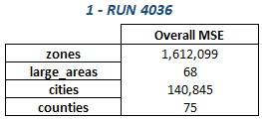
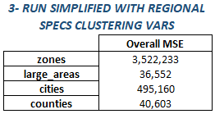
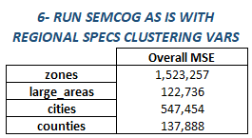
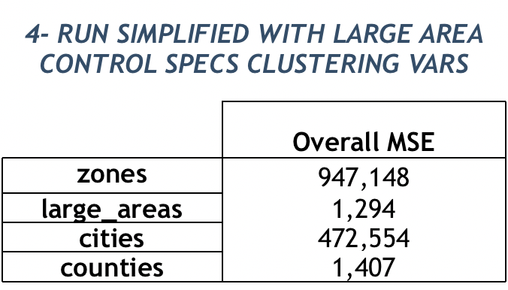
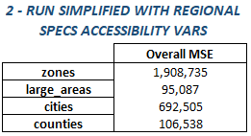
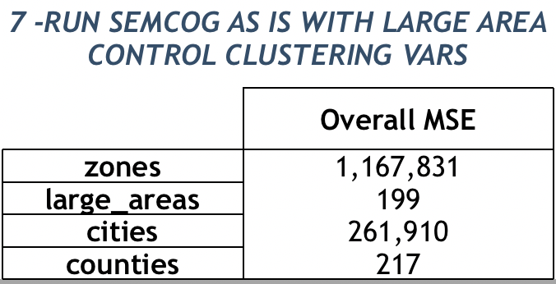
Loss Values for each Run
Notes:
Where our target is the official Semcog Results

Slide 11
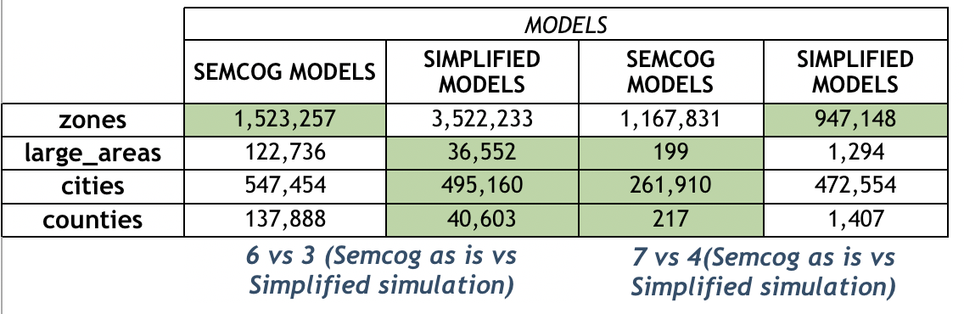
Comparison:

Slide 12
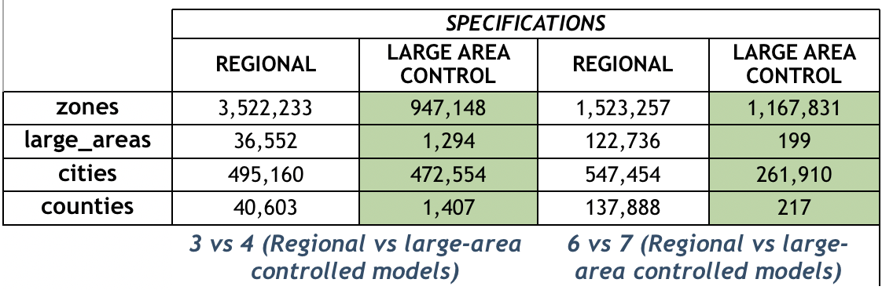
Comparison

Slide 13
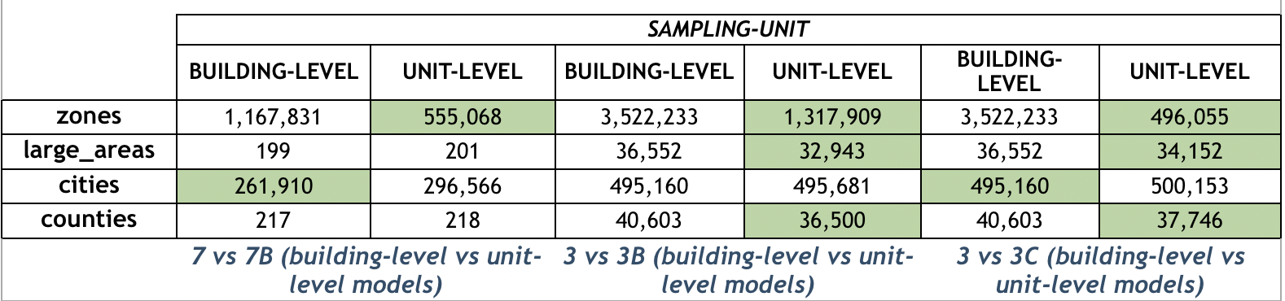
Comparison
Notes:
3B has only hclms while 3C has hlcm and elcm with unit level sampling
Most difference is in job sectors 7 and 7B

Slide 14
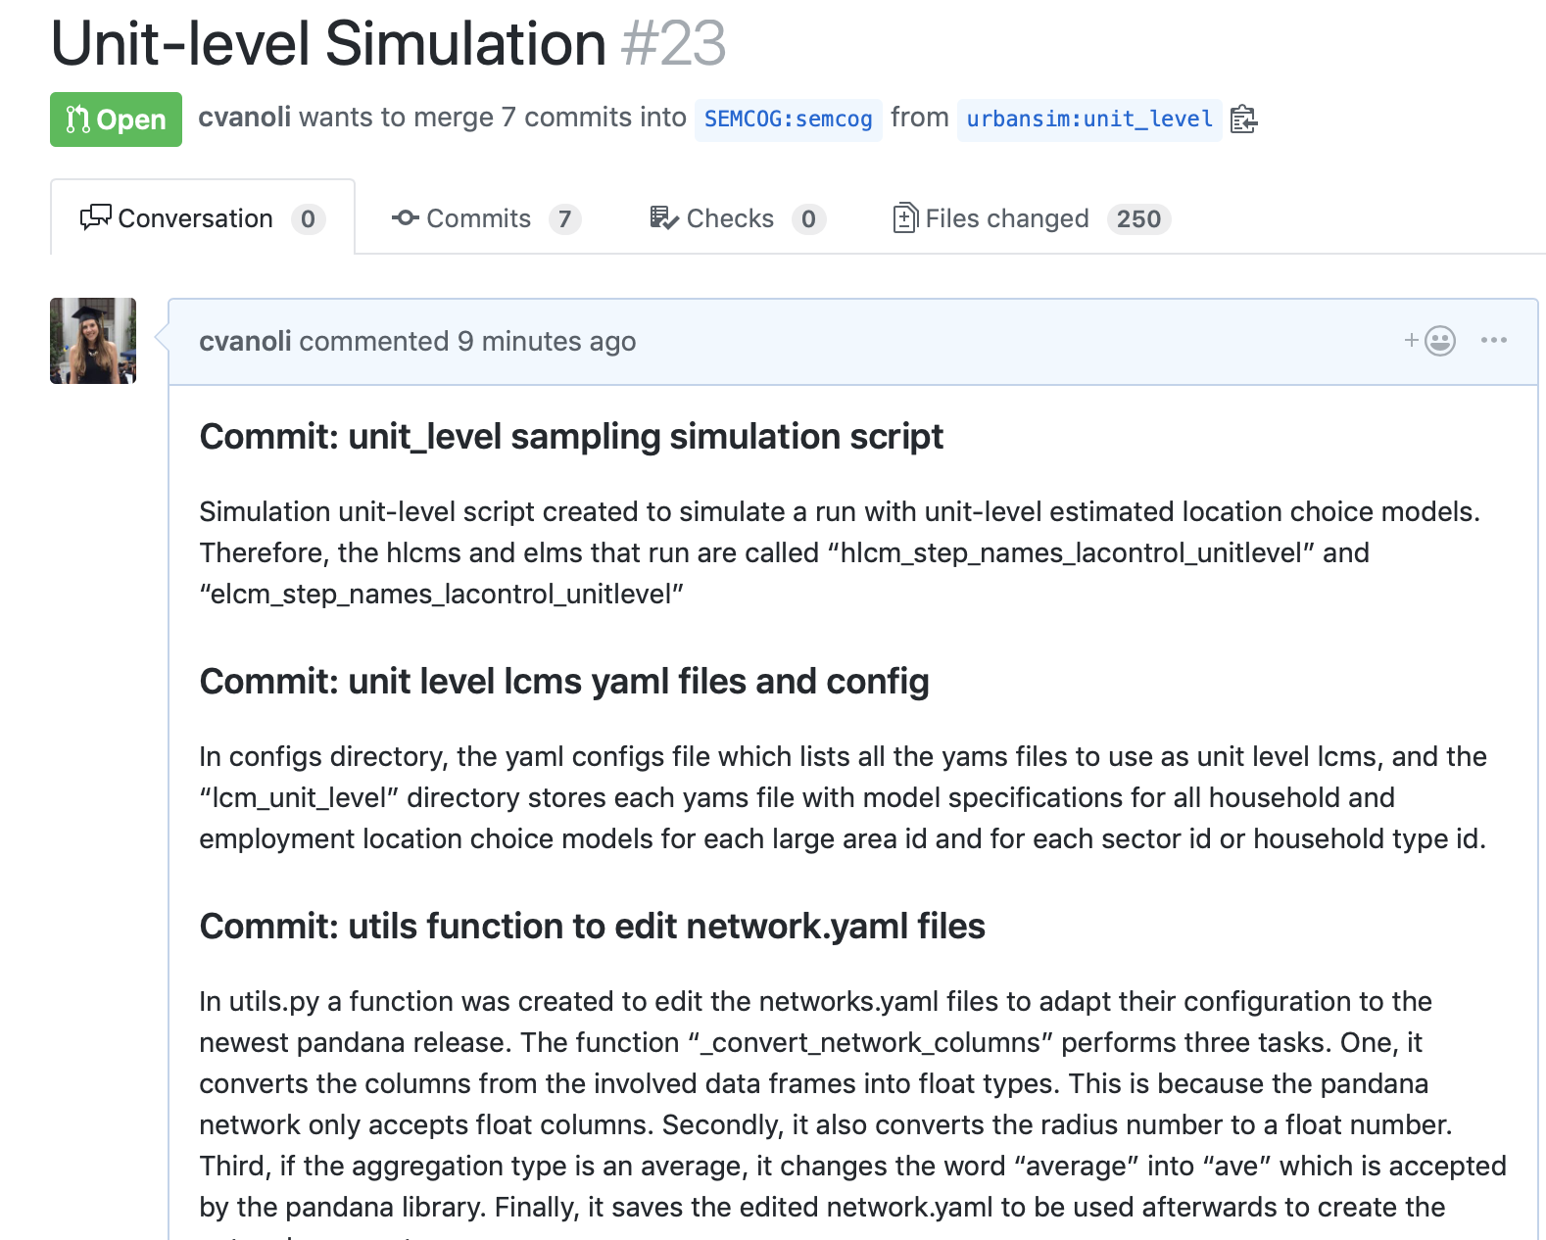
Pull Request on Github:
Forked SEMCOG repository, unit-level branch
Created PR with unit-level models and Simulation script
https://github.com/SEMCOG/semcog_urbansim/pull/23
Notes:
3B has only hclms while 3C has hlcm and elcm with unit level sampling

Slide 15
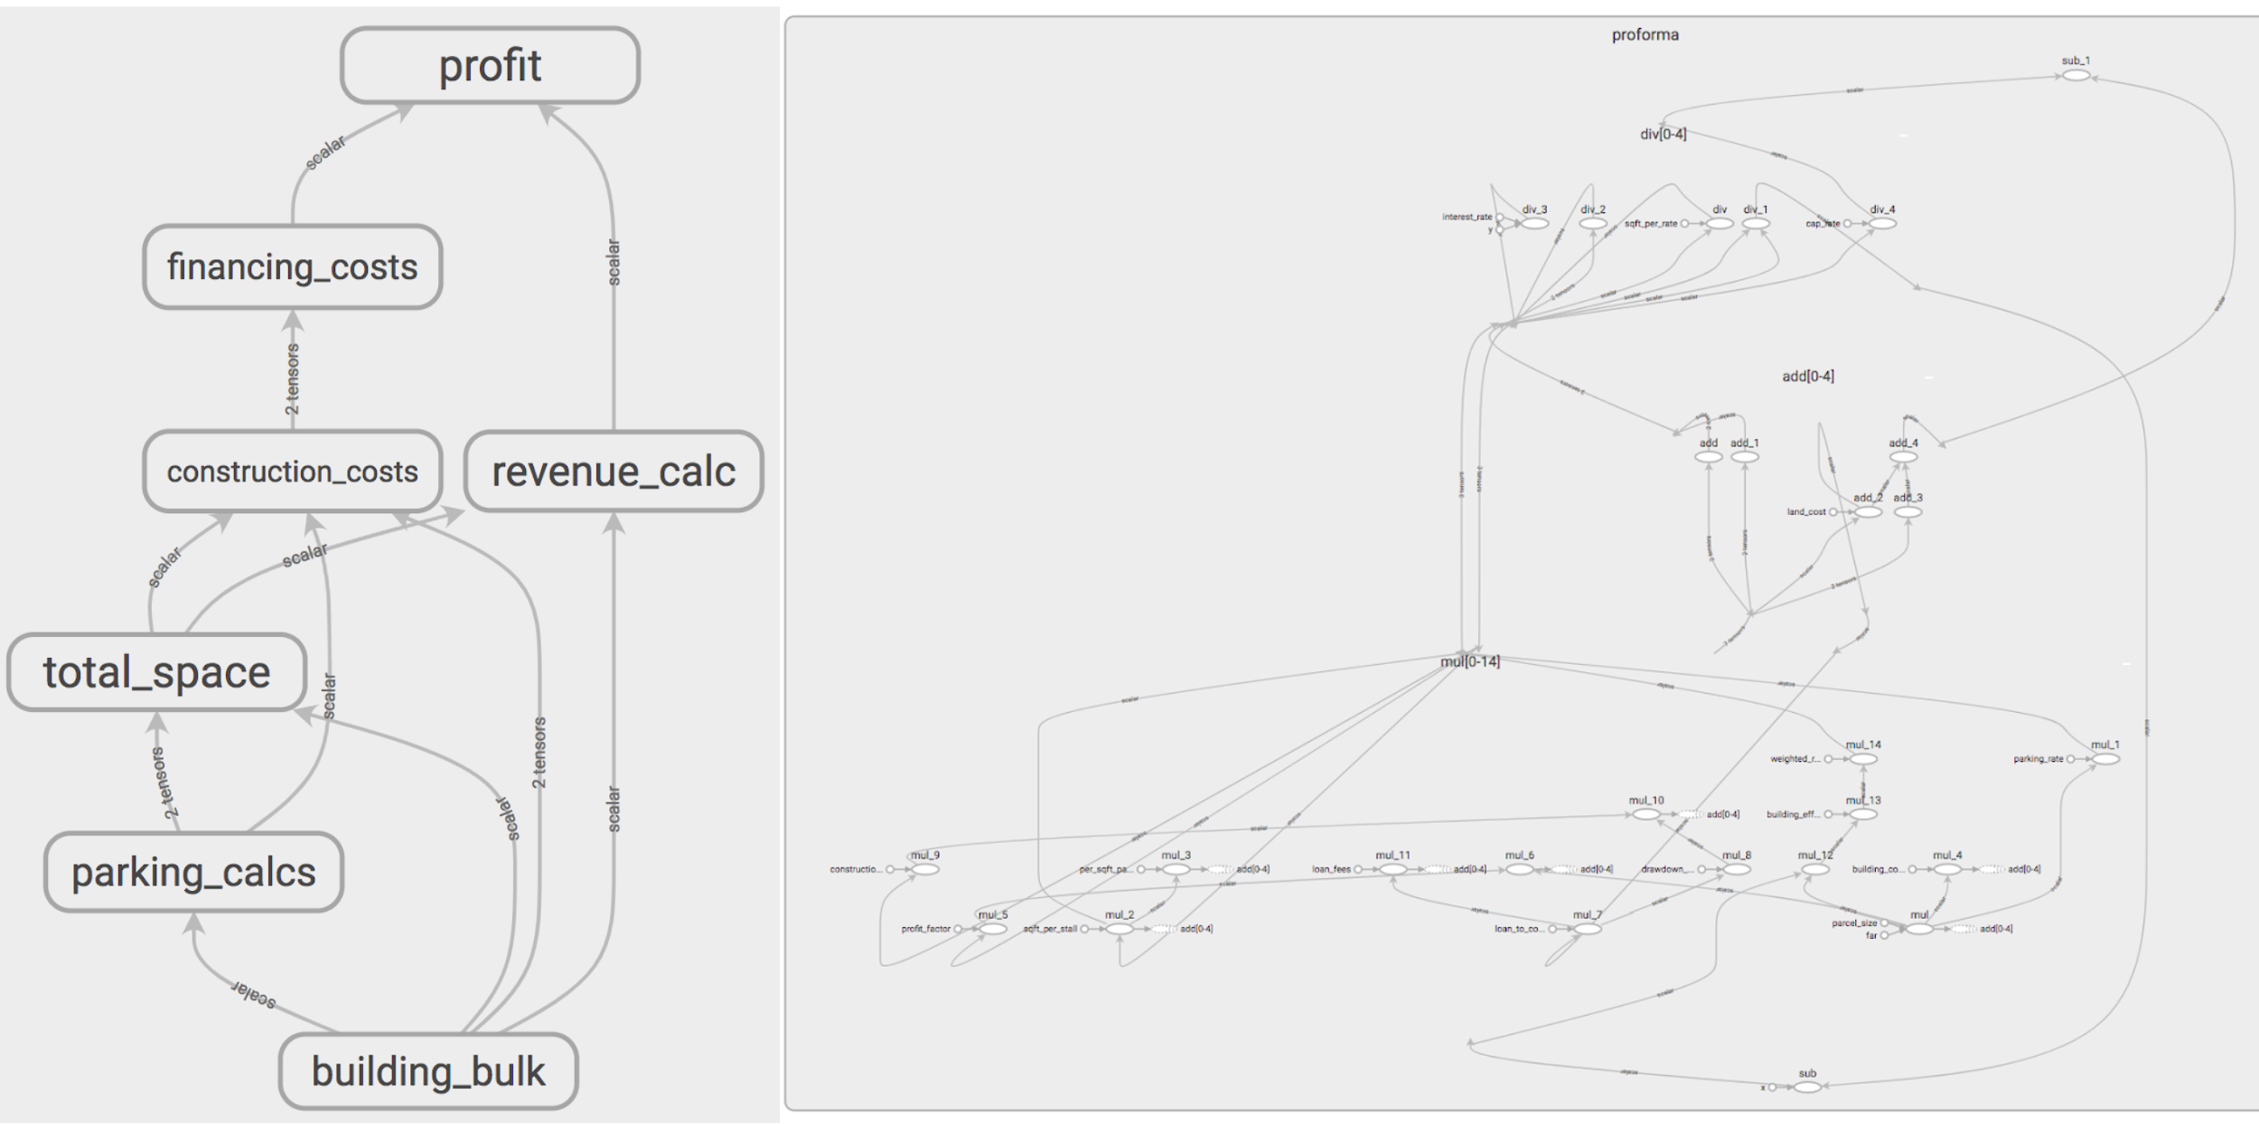

Slide 16
Questions regarding calibrating proforma
From run 4036 to the official forecast, were there supply-side adjustments?
Calibrate with or without scheduled development events?
Calibrate with the existing cost shifters as a starting point?

